Slide 1
sources of funding
An overview
How to approach funding decisions:
“A project leader looking for a fund or …… a fund follower looking for a project!”
Where to find information
How to approach applications
Examples and Questions

Slide 2
General Sources of Funding
overview
Donor | Funder | Purchaser | Consumer
Gifts | Grants | Contracts | Open Market
ASKING EARNING
Courtsey NCVO Sustainable Funding Project

Slide 3
Gifts
Made by individuals (or corporates) to further the mission of an organisation
Here the relationship is with a “donor”
  Community Fundraising
  On street collections
  Events
  Fundraising Drives/Appeals
  Payroll Giving
  Telesales
  Legacy Campaigns
  Crowdfunding/Giving Circles
  Corporate

Slide 4

Grants
Restricted funding to deliver specific work
Often received after an application process
Here there is a relationship with a “funder”
  Trusts & Foundations
  Statutory
  Local Government
  Central Government
  European Union
  Corporate
  International/Diaspora

Slide 5

Contracts
Usually involve payment for provision of products or services according to agreed terms
Often between voluntary organisations and public bodies
Relationship here is with a “purchaser”
  Public Body
  Statutory Agency/Semi State
  Procurement/Tendering contract for services
  Increasingly Private Sector
  Increasingly Foundations & Trusts

Slide 6

Open Market
Means selling products or services to customers
Not as part of a long-term structured contract
Trading and enterprise activity
Providing services or advice for a fee
Relationship here is with a “customer”
  Traded Goods & Services
  Cause Marketing
  Social Enterprises
  Charity Shops
  Online

Slide 7
Project to fund or
Fund to project
What are your priorities?
What plans do you have you would like to realise and in what timeframe?
Is your project part of the Ballinamore Area Strategy or does it feed into its priorities

Slide 8
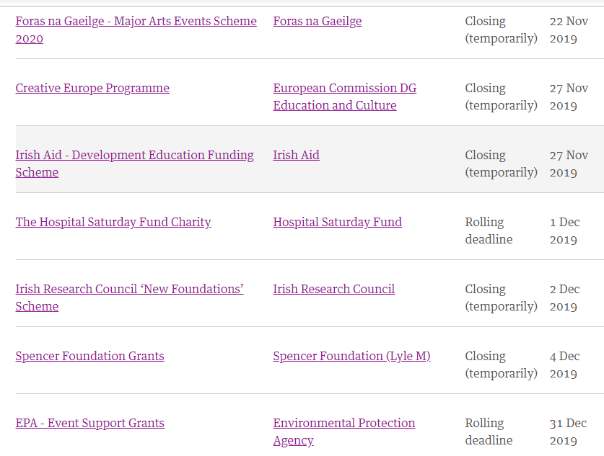
See the document prepared especially for this workshop
Review the Wheel’s fundingpoint website

Slide 9
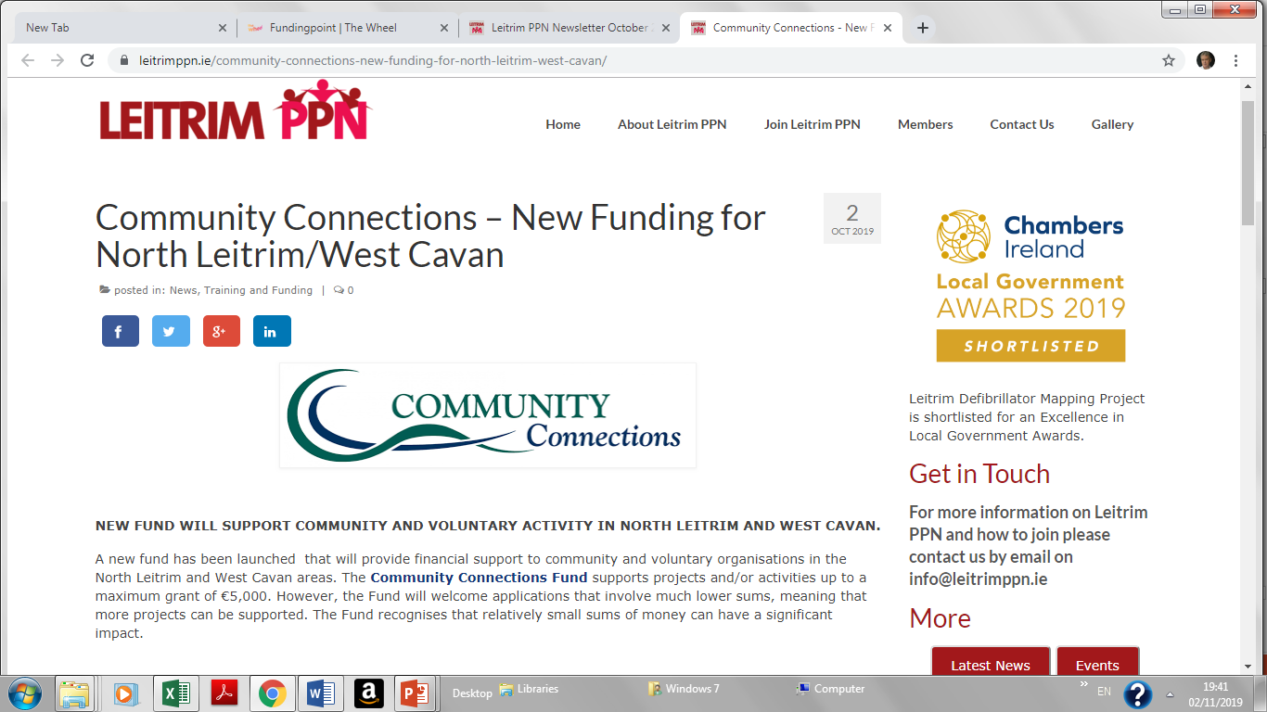
Sources of grant information
http://www.failteireland.ie
https://www.gov.ie/en/organisation/department-of-rural-and-community-development/
https://www.internationalfundforireland.com
https://www.leitrimcoco.ie
https://www.leitrimppn.ie
https://www.pobal.ie
https://www.seai.ie
https://www.seupb.eu/

Slide 10
WRITING applications

Slide 11

Types
Free Form Applications
Form Applications

Slide 12

Process
Research; Who supports your area of work? [Dept, Agency, EU, Company, Foundation]
Research the funder
Check & confirm eligibility
Choose the appropriate writing style
Prepare your projects reference material
  (Annual report and accounts, project plan, project budget, Job specs, Evidence need etc)
Check Forms & Guidelines
Recruit Help
(Finance/Treasurer for budget, People to proof and edit, others working on the project)

Slide 13
Process
Schedule Time
Session 1: Collect information and details, contact info
Session 2: Aims, Objectives, Activities, Outcomes etc
Session 3: Project Budget
Assess The Form
What is the funder looking for?
Have you answered their requirements correctly and succinctly?
Any doubts; seek clarification

Slide 14
Common Questions To Expect
Your Contact Details
Address, email and telephone, Staff, volunteers, CHY/Legal status, Account details, turnover
Aims & Objectives of your organisation
Vision, mission, values, reason for existing
Background & History of your organisation
Proof of capacity to deliver, proven track record
Activities your organisation engages in
What are your main activities, who does them, who do you help, evidence of impact (N.B.)

Slide 15
Free Form Applications
Covering Letter
Brief outline of the who, what how, where, when and why
Main Application (2 paragraphs)
Background to your work, history of org, aims & objectives, vision mission & values etc
Background to your area/client group (2–3 paragraphs)
Identify problems, needs, who is doing what, what/who is succeeding
Project Rationale (1 paragraph)
Why are you doing what you are doing and why this is the solution to the specified problem
The Project (3–4 paragraphs)
The name of the project, summarise the components, benefits, evidence base, evaluation
Budget (1–2 paragraphs + table)
Breakdown of costs, include any ‘in kind donations
Grant Request
How much are you requesting from the funder?
Enclosures
Copies of constitution, annual accounts any supporting documentation only when requested

Slide 16
Form Applications
When filling out a grant application form always remember to do the following:
  Stick to the word count
  Answer the question the section asks and that alone
  Less is more, you don’t have to fill in the space just because it is there. The more succinct you can make your point the better
  Think of the assessor having to mark/grade it. Make it easy for them
  Avoid repetition
  Some application forms don’t always match the assessment criteria. Clarify with grant maker in that instance but err on the side of what the assessor is looking for.

Slide 17
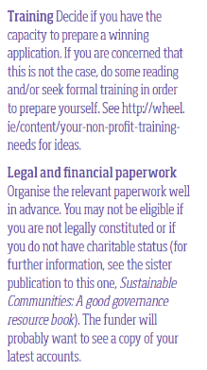
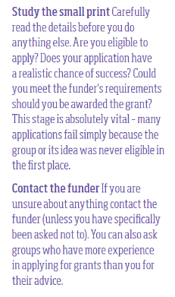
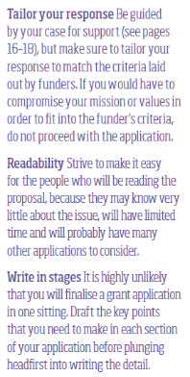
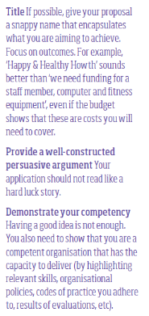
Tips for Writing A Successful Funding Application
1
3
5
8
2
6
9
4
10
7

Slide 18
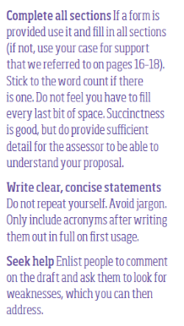
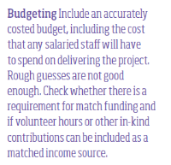
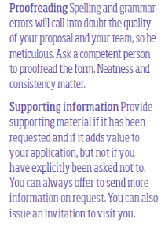
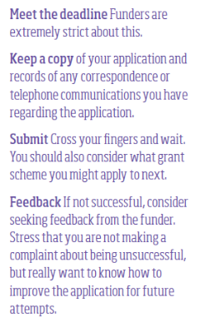
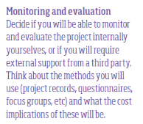
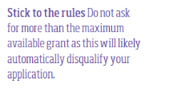
Tips for Writing A Successful Funding Application
14
16
19
11
20
17
21
12
15
22
18
13

Slide 19

Once You Submit
Know what happens next
Know how it is progressing
Keep records of correspondence
Make more applications

Slide 20
Success V Failure

Slide 21

TEN REASONS WHY APPLICATIONS FAIL
The applicant is not eligible for reason of its legal form, lack of charity status, size or geographical remit.
Projects are not well planned.
Applicants do not present their project clearly and concisely on the application form.
The applicant fails to demonstrate that they meet the criteria or asks for something the funder will not fund.
Applications are made without monitoring and evaluation processes in place.
The budget is problematic and/or unconvincing financial management procedures.
The applicant misses the deadline.
The form is incomplete or illegible.
The supporting documents are incomplete, inaccurate, out-of-date, contradict the application form or are simply not enclosed.
The applicant is asking for too much

Slide 22

TEN REASONS WHY APPLICATIONS SUCCEED
The organisation makes an application.
The need for the project is strongly evidenced and the applicant convinces the funder that it is the best placed organisation to tackle it.
The applicant chooses the most appropriate funders to approach.
The applicant researches the funder intensively before an application is made.
The application is received by the deadline – fully completed with up-to-date annual report and accounts, governing documents, bank account details and all other relevant enclosures.
The applicant has an amiable working relationship with the funder through the application process.
The application stands out against other applications for the same pot of money and the funder can see what it is getting for its money.
The budget is accurately costed, sources of match funding are in place and the applicant asks for a realistic amount from the funder.
The applicant has good governance, management, administration and financial procedures in place.
The applicant has a good track record in delivering funded projects.

